Slide 1
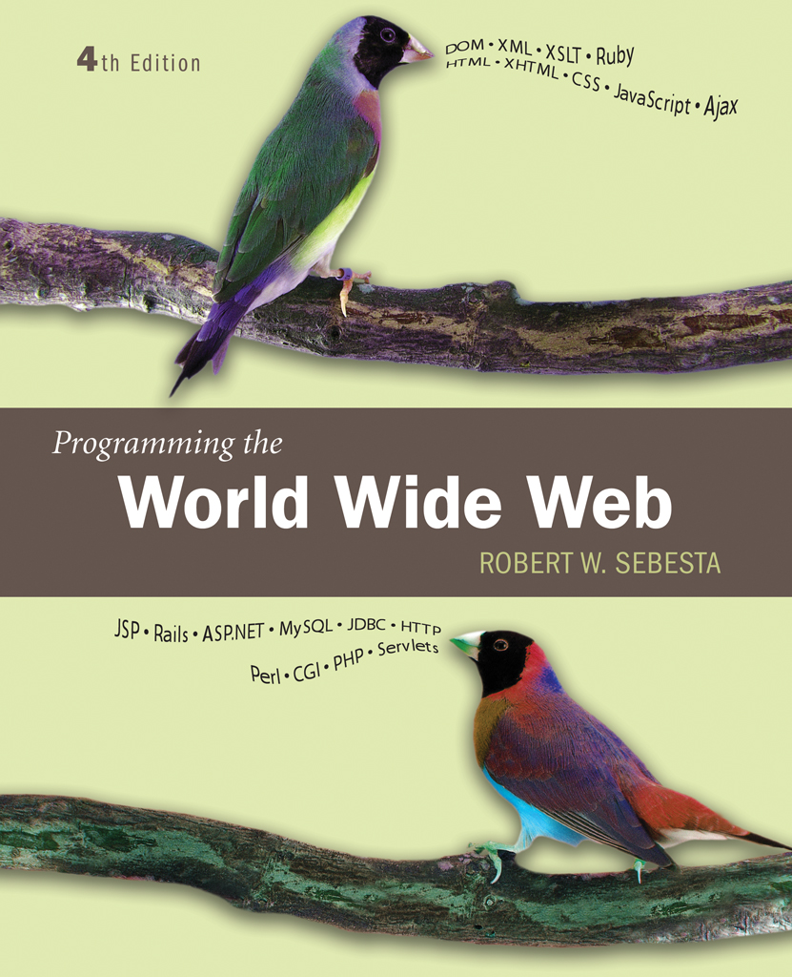
Chapter 6
Dynamic
Documents
With JavaScript

Slide 2
6.1 Introduction
Using DOM, JavaScript can change the document in which it is embedded
Elements can be moved
Style can be changed
Visibility can be changed
What is a dynamic XHTML document?

Slide 3
6.2 Element Positioning
CSS-P provides powerful tools to position elements in a web page
The position property specifies the position mode
  Value are absolute , relative and static
The left and top properties specify element position
  A positive value of top pushes the element down
  A positive value of left pushes the element to the right
  A negative value of top pushes the element up
  A negative value of left pushes the element to the left

Slide 4
6.2 Absolute Positioning
Absolute position specifies where an element appears relative to the containing element
Example:
<p style=“position:absolute; left:100px; top:200px”>
--text—
</p>
One of the use is to superimpose special text over a paragraph of ordinary text
Use of width property
Nesting of elements absolutely positioned

Slide 5
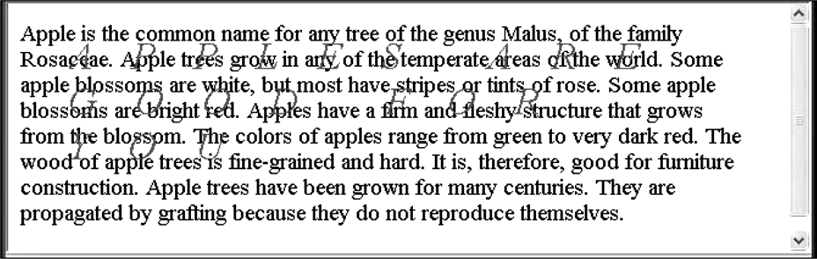
Figure 6.1 Display of absPos.html

Slide 6
6.2 Static and Relative Positioning
In static position mode, the default, elements are placed left to right, top to bottom
  The top and left properties are ignored for static positioning
Relative position mode allows changing position relative to where the element would be with static positioning
This could be used to create superscripts or subscripts by moving text up or down relative to its normal position

Slide 7
6.3 Moving Elements
JavaScript code can move elements by changing the top and left properties
  Note that the position mode has to be relative or absolute for this to work
Example mover.html illustrates dynamically placing elements
  Text input fields are provided to enter the x and y coordinates desired for the displayed image
  An image element has an id attribute and style to specify it as absolute position
  An event handler on a button gets values from the text fields and uses those as parameters to a JavaScript function
  The function gets a style node from the image element (variable dom)
  The top and left properties of the style element are changed (note the px appended as a unit)

Slide 8
6.4 Element Visibility
Example showHide.html illustrates hiding and showing an element by manipulating the visibility property
The JavaScript code accesses the style node for the image element (variable dom)
The visibility property of the style node is altered to change the visibility of the element

Slide 9
6.5 Changing Colors and Fonts
Colors and font properties can be manipulated through the style property of an element
What are the properties used ?

Slide 10
6.5 Changing Colors
Example dynColors.html illustrates setting background and foreground colors
The change event is used which triggers a change depending on which text box was used
Note this is used to refer to the input tag triggering the event

Slide 11
6.5 Changing Fonts
The dynLink example illustrates changing font properties using JavaScript
A mouseover event on a link causes the font to change
A mouseout event on the same link causes the font to change back to the original

Slide 12
6.6 Dynamic Content
By manipulating the DOM tree representing the document, the document content can be changed
The dynValue.html example illustrates dynamic content by changing the content of a text area when the mouse moves over other components
The mouseover and mouseout events are used to control this
dynValue.js contains an array of help messages and a function which displays the help message into the help box.
The value property of the ‘help’ box is used to change the content

Slide 13
6.7 Stacking Elements
The z-index style property can be used to govern the layering of elements in the display
  If two elements both cover a part of the window, the element with the higher z-index value will cover the other one
  Z-index values as with other properties is also a string
The stacking.html example illustrates manipulating the z-index property dynamically

Slide 14
6.8 Locating the Mouse Cursor
An event object created for a mouse related event has properties that give the coordinates of the mouse position at the time of the event
  clientX and clientY give the position in pixels relative to the upper left-hand corner of the browser window
  screenX and screenY give the mouse position relative to the upper left-hand corner of the screen
The event object is available as an object named event
  In Mozilla/Firefox the object can be accessed by passing it as a parameter to the event handler
  In Internet Explorer, the object is a global
The where.html example illustrates these points

Slide 15
6.9 Reacting to a Mouse Click
The anywhere.html example is another example using mouse location information
The example uses mousedown and mouseup events to drive the action
The position and visibility of an element are manipulated by the event handler

Slide 16
6.10 Slow Movement of Elements
JavaScript provides methods to time activities
setTimeout will execute some JavaScript code at one time in the future
setInterval will execute a JavaScript function at evenly spaced times in the future

Slide 17
6.10 Function setTimeout
Takes two parameters
  A string containing valid JavaScript code (similar to an event attribute value)
  A non-negative number
The numeric parameter specifies a number of milliseconds
After that number of milliseconds, the JavaScript code is executed
Example:
setTimeout(“mover()”,20);

Slide 18
6.10 Function setInterval
This method has two forms:
One form takes two parameters as setTimeout
Second form takes variable number of parameters
  First parameter is the function to be called
  Second is the interval in milliseconds between executions
  Remaining parameters are used as actual parameters to the function
Thereafter, at an interval given by the second parameter, the function is called over and over

Slide 19
6.10 Example moveText.html
A string of text is moved from one position to another
setTimeout is used to move the text in incremental steps
  The function executed by setTimeout, moveText, will call setTimeout again provided the text is not in its final position
  The call to setTimeout includes the current text position as parameters to moveText
The text position is encoded as strings with units, as required by CSS, so this text must be decoded to numerical form to perform arithmetic

Slide 20
6.11 Dragging and Dropping Elements
Example dragNDrop.html illustrates dynamically modifying event handlers in order to provide dragging and dropping functionality
The grabber method is invoked on mousedown on an element
  The grabber method assigns handlers for the target for the mouseup and mousemove events
  The grabber method also determines coordinates for the target element so that it can be properly placed when the mouse moves
The mouseup event handler, dropper, undoes the event registrations
The mousemove event handler moves the target element

Slide 21
Chapter 11
Introduction to PHP

Slide 22
11.1 Origin and Uses of PHP
Developed by Rasmus Lerdorf in 1994
PHP is a server-side scripting language, embedded in XHTML pages
PHP has good support for form processing
PHP can interface with a wide variety of databases
PHP has also support for the distributed object architecures

Slide 23
11.2 Overview of PHP
When a PHP document is requested from a server, the server will send the document first to a PHP processor by seeing the file extension of the file
ex: .php, .phtml, .php3 etc
The result of the processing is the response to the request
PHP has two modes of operation
  Copy mode in which plain HTML is copied to the output
  Interpret mode in which PHP code is interpreted and the output from that code sent to output
  The client never sees PHP code, only the output produced by the code
PHP has typical scripting language characteristics
  Dynamic typing, untyped variables
  Associative arrays
  Pattern matching
  Extensive libraries

Slide 24
11.3 General Syntactic Characteristics
PHP code is contained between the tags <?php and ?>
Code can be included with the PHP include
include(“table2.inc”);
When a file is included, the PHP interpreter reverts to copy mode
  Thus, code in an include file must be in <?php and ?> tags
All variable names in PHP begin with $ and continue as usual for variables
Variable names are case sensitive
However keywords and function names are not case sensitive

Slide 25
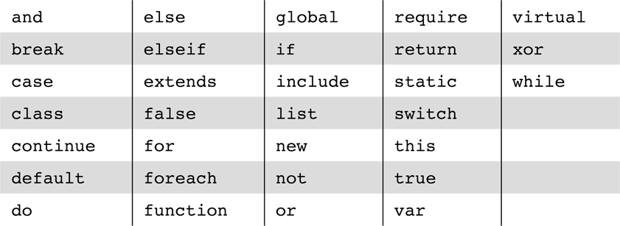
Table 11.1 The reserved words of PHP

Slide 26
11.3 PHP Syntax
One line comments can begin with # or // and continue to the end of the line
Multi-line comments can begin with /* and end with */
PHP statements are terminated with semicolons
Curly braces are used to create compound statements
Variables cannot be defined in a compound statement unless it is the body of a function

Slide 27
11.4 Primitives, Operations, Expressions
Four scalar types: boolean, integer, double, string
Two compound types: array, object
Two special types: resource and NULL

Slide 28
11.4 Variables
Variables are not declared except in order to specify scope or lifetime
A variable that has not been assigned a value is unbound and has the value NULL
  NULL is coerced to 0 if a number is needed, to the empty string if a string is needed
  Both of these coercions count as boolean FALSE
Variable is tested using IsSet() function, which takes variable names as its parameter and returns true or false
Unset function is used to set back to unassigned state
The error_reporting function is used to set the level of problems that will be reported
  For example, level 15 includes reporting unbound variable errors
The default error-reporting value is 7

Slide 29
11.4 Integer Type
PHP distinguishes between integer and floating point numeric types
Integer is equivalent to long in C, that is, usually 32 bits

Slide 30
11.4 Double Type
Literal double type numeric values include a period and/or the exponent sign: either e or E
Double type values are stored internally as double precision floating point values
Ex: both 345. and .345 are legal

Slide 31
11.4 String Type
Characters in PHP are one byte
String literals are enclosed in single or double quotes
  Double quoted strings have escape sequences interpreted and variables interpolated(the substitution)
  Single quoted strings have neither escape sequence interpretation nor variable interpolation
  A literal $ sign in a double quoted string must be escaped with a backslash, \
Double-quoted strings can cover multiple lines, the included end of line characters are part of the string value
ex: the line ‘the sum is $sum’ is typed exactly but
if the value of $sum=12 then if you write
“the sum is $sum” will be printed as
the sum is 12

Slide 32
11.4 Boolean Type
The boolean type has two values :TRUE and FALSE
Other type values are coerced as needed by context, for example, in control expressions
  The integer value 0, the empty string and the literal string “0” all count as false
  NULL counts as false
  The double value 0.0 counts as false. Beware, however, that double calculations rarely result in the exact value 0.0
  The string “0.0” evaluates to true so don’t use this value

Slide 33
11.4 Arithmetic Operators and Expressions
PHP supports the usual operators supported by the C/C++/Java family
Integer divided by integer results in integer if there is no remainder but results in double if there is a remainder
  12/6 is 2
  12/5 is 2.4
A variety of numeric functions is available: floor, ceil, round, srand, abs, min, max

Slide 34
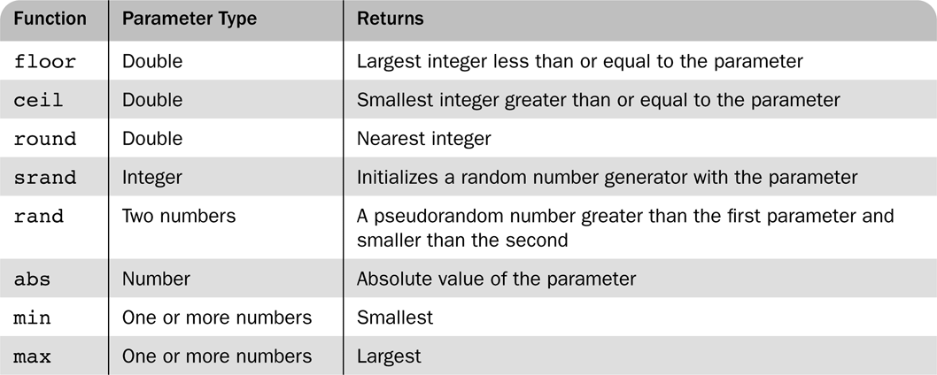
Table 11.2 Some useful predefined functions

Slide 35
11.4 String Operations
String catenation is indicated with a period
Characters are accessed in a string with a subscript enclosed in curly braces
ex: if $str=“Apples” then $str{1} is “p”
Many useful string functions are provided
  strlen gives the length of a string
  strcmp compares two strings as strings
  Chop removes whitespace from the end of a string

Slide 36
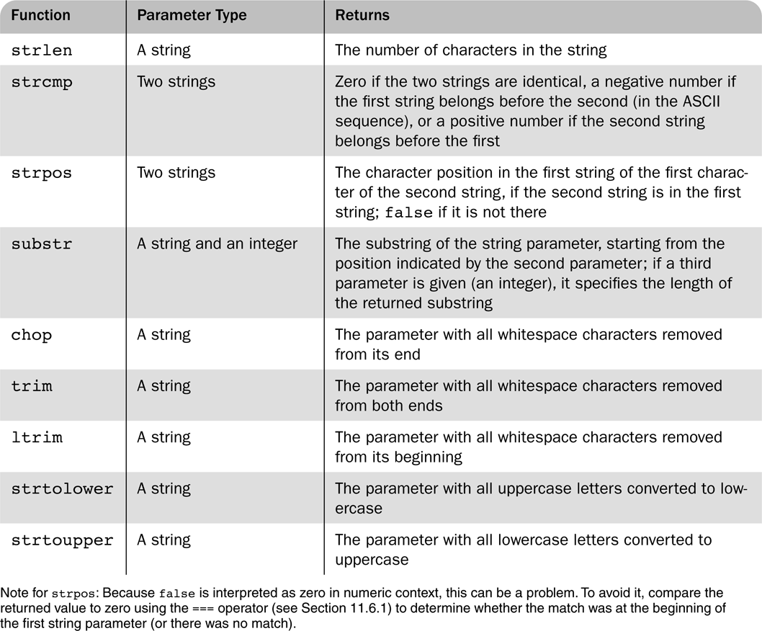
Table 11.3 Some commonly used string functions

Slide 37
11.4 Scalar Type Conversions
Implicit type conversions as demanded by the context in which an expression appears
  A string is converted to an integer if a numeric value is required and the string has only a sign followed by digits
  A string is converted to a double if a numeric value is required and the string is a valid double literal (including either a period or e or E)
Type conversions can be forced in three ways
  (int)$sum in the C style
  intval($sum) using several conversion functions
  settype($x, “integer”)
Type can be determined with the gettype function and with the is_int function and similar functions for other types

Slide 38
11.4 Assignment Operators
The assignment operators used in C/C++/Java are supported in PHP

Slide 39
11.5 Output
The print function is used to send data to output
  print takes string parameters, PHP coerces as necessary
The C printf function is also available
  The first argument to printf is a string with interspersed format codes
  A format code begins with % followed by a field width and a type specifier
  Common types specifiers are s for string, d for integer and f double
  Field width is a single integer to specify the number of characters (minimum) used to display the value or two integers separated by a period to indicate field width and decimal places for double values
  printf(“x = %5d is %s\n”, $x, $size);
  Displays $x as an integer and $size as a string
The example today.php uses the date function to dynamically generate a page with the current date

Slide 40
11.6 Relational Operators
PHP has the usual comparison operators: >, < <=, >=, == and !=
PHP also has the identity operator ===
  This operator does not force coercion
The regular comparisons will force conversion of values as needed
  Comparing a string with a number (other han with ===) will result in the string converting to a number if it can be. Otherwise the number is converted to a string
  If two strings are compared (other than with ===) and the strings can both be converted to numeric values, the conversion will be done and the converted values compared
  Use strcmp on the strings if the latter feature is a problem

Slide 41
11.6 Boolean Operators
PHP supports &&, || and ! as in C/C++/Java
The lower precedence version and and or are provided
The xor operator is also provided

Slide 42
11.6 Selection Statements
PHP provides an if with almost the same syntax as C/C++/Java
  The only difference is the elseif (note, not elsif as in Perl)
The switch statement is provided with syntax and semantics similar to C/C++/Java
  The case expressions are coerced before comparing with the control expression
  break is necessary to prevent execution from flowing from one case to the next

Slide 43
11.6 Loop Statements
PHP provides the while and for and do-while as in JavaScript
The for loop is illustrated in the example powers.php
This example also illustrates a number of mathematical functions available in PHP
Compute the sum of the positive integers up to 100? Using loop statements
It also provides break, continue, foreach statements

Slide 44
11.7 Arrays
Arrays in PHP combine the characteristics of regular arrays and hashes
  An array can have elements indexed numerically. These are maintained in order
  An array, even the same array, can have elements indexed by string. These are not maintained in any particular order
The elements of an array are, conceptually, key/value pairs

Slide 45
11.7 Array Creation
Two ways of creating an array
  Assigning a value to an element of an array
  Using the array function
Create a numerically indexed array
  array(23, ‘xiv’, “bob”, 777);
Create an array with string indexes
  array(“x” => “xerxes”, “y” => “ytrbium”)

Slide 46
11.7 Accessing Array Elements
Array elements are accessed by using a subscript in square brackets
An array can be assigned to a list of variables
  list($x, $y, $z) = array($y, $z, $x)

Slide 47
11.7 Functions for Dealing with Arrays
The unset function can be used to remove an array or an element of an array
The array_keys function returns a list of the keys of an array
The array_values returns a list of values in an array
The array_key_exists function returns true if a given key is actually present in a given array
is_array determines if its argument is an array
implode converts an array of strings to a single string, separating the parts with a specified string
explode converts a string into a list of strings by separating the string at specified characters

Slide 48
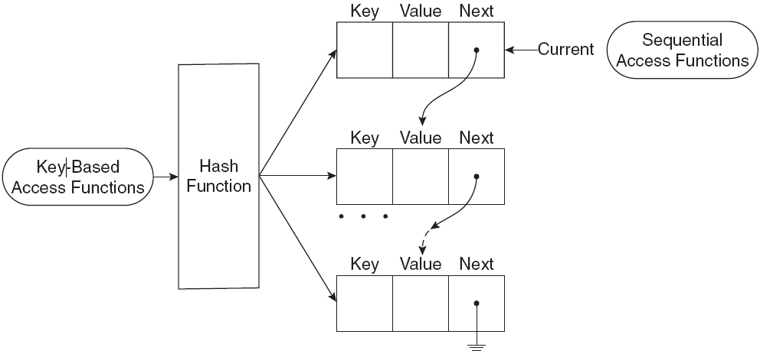
11.7 Logical Internal Array Structure

Slide 49
11.7 Sequential Access to Array Elements
PHP maintains a marker in each array, called the current pointer
  Several functions in PHP manipulate the current pointer
  The pointer starts at the first element when the array is created
The next function moves the pointer to the next element and returns the value there
The each function move the pointer to the next element and returns the key/value pair at the previous position
  The key and value can be accessed using the keys “key” and “value” on the key/value pair
Both functions return false if no more elements are available
prev moves the pointer back towards the beginning of the array
reset moves the pointer to the beginning of the array

Slide 50
11.7 Arrays as Stacks
PHP provides the array_push function that appends its arguments to a given array
The function array_pop removes the last element of a given array and returns it

Slide 51
11.7 Iterating Through an Array
The foreach statement has two forms for iterating through an array
foreach (array as scalar_variable) loop body
foreach (array as key => value) loop body
The first version assigns each value in the array to the scalar_variable in turn
The seconf version assigns each key to key and the associated value to value in turn
In this example, each day and temperature is printed
  $lows = array("Mon" => 23, "Tue" => 18, "Wed" => 27);
  foreach ($lows as $day => $temp)
  print("The low temperature on $day was $temp <br />");

Slide 52
11.7 Sorting Arrays
The sort function sorts the values in an array and makes a numerically subscripted array from the sorted list
The function asort sorts the values in an array but keeps the original key/value association
The function ksort is similar to asort but sorts by keys
The functions rsort, arsort and krsort are similar but sort in reverse order
The example sorting.php illustrates the various sort functions

Slide 53
11.8 General Characteristics of Functions
Function syntax
  function name([parameters]) {
  ...
  }
The parameters are optional, but not the parentheses
Function names are not case sensitive
A return statement causes the function to immediately terminate and return a value, if any, provided in the return
A function that reaches the end of the body without executing a return, returns no value

Slide 54
11.8 Parameters
A formal parameter, specified in a function declaration, is simply a variable name
If more actual parameters are supplied in a call than there are formal parameters, the extra values are ignored
If more formal parameters are specified than there are actual parameters in a call then the extra formal parameters receive no value
PHP defaults to pass by value
  Putting an ampersand in front of a formal parameter specifies that pass-by-reference
  An ampersand can also be appended to the actual parameter (which must be a variable name)

Slide 55
11.8 The Scope of Variables
A variable defined in a function is, by default, local to the function
A global variable of the same name is not visible in the function
Declaring a variable in a function with the global declaration means that the functions uses the global variable of that name

Slide 56
11.8 Lifetime of Variables
The usual lifetime of a local variable is from the time the function begins to execute to the time the function returns
Declaring a variable with the static keyword means that the lifetime is from the first use of the variable to the end of the execution of the entire script
In this way a function can retain some ‘history’

Slide 57
11.9 Pattern Matching
PHP provides both POSIX regular expressions and Perl regular expressions
  These are generally the same but differ in certain details
The preg_match function matches a pattern, given as a string, with a string
The preg_split function splits a string into an array of strings based on a pattern describing the separators
The word_table.php example illustrates pattern matching in PHP

Slide 58
11.10 Form Handling
The values from forms can be accessed in PHP using the $_POST and $_GET arrays
  Some web servers allow more direct access, though this has security implications
The files popcorn3.html and popcorn3.php implement the popcorn order form using PHP
  The printf function is used to get two decimal places printed for currency values

Slide 59
11.11 Opening and Closing Files
The PHP function fopen is used to create a file handle for accessing a file given by name
A second argument to fopen gives the mode of access
The fopen function returns a file handle
Every open file has a current pointer indicating a point in the file
Normally input and output operations occur at the current pointer position
The file_exists function tests if a file, given by name, exists
The function fclose closes a file handle

Slide 60
11.11 File Use Indicators
Mode | Description
"r" | Read only. The file pointer is initialized to the beginning of the file.
"r+" | Read and write an existing file. The file pointer is initialized to the beginning of the file; if a read operation precedes a write operation, the new data is written just after where the read operation left the file pointer.
“w" | Write only. Initializes the file pointer to the beginning of the file; creates the file if it does not exist.
"w+" | Read and write. Initializes the file pointer to the beginning of the file; creates the file if it does not exist. Always initializes the file pointer to the beginning of the file before the first write, destroying any existing data.
"a" | Write only. If the file exists, initializes the file pointer to the end of the file; if the file does not exist, creates it and initializes the file pointer to its beginning.
"a+" | Read and write a file, creating the file if necessary; new data is written to the end of the existing data

Slide 61
11.11 Reading from a File
The fread function reads a given number of bytes from a file given by a file handle
  The entire file can be read by using the filesize function to determine the number of bytes in the file
The file function returns an array of lines from a file named as a parameter
  No explicit open and close are required for using this function, it does not use a file handle parameter
The file_get_contents method returns the content of a named file as a single string
The fgetc function returns a single character
The feof function returns TRUE if the last character read was the end of file marker, that is, the read was past the end of the file

Slide 62
11.11 Writing to a File
If a file handle is open to for writing or appending, then the fwrite function can be used to write bytes to the file
The file_put_contents function writes a given string parameter to a named file, not a file handle

Slide 63
11.11 Locking Files
The flock function will locka a named file
The function takes a second parameter giving the mode of the lock
  1 specifies others can read
  2 specifies no other access is allowed
  3 removes the lock

Slide 64
11.12 Cookies
HTTP is a stateless protocol, that is, the server treats each request as completely separate from any other
This, however, makes some applications difficult
  A shopping cart is an object that must be maintained across numerous requests and responses
The mechanism of cookies can be used to help maintain state by storing some information on the browser system
A cookie is a key/value pair that is keyed to the domain of the server
  This key/value pair is sent along with any request made by the browser of the same server
A cookie has a lifetime which specifies a time at which the cookie is deleted from the browser

Slide 65
11.12 Cookies and Security
Cookies are only returned to the server that created them
Cookies can be used to determine usage patterns that might not otherwise be ascertained by a server
Browsers generally allow users to limit how cookies are used
  Browsers usually allow users to remove all cookies currently stored by the browser
Systems that depend on cookies will fail if the browser refuses to store them

Slide 66
11.12 PHP Support for Cookies
PHP provides the setcookie function to set a cookie in a response
  The first parameter is the cookie’s name
  The second, optional, parameter gives the cookie’s value
  The third, optional, parameter gives the expiration
The cookie must be set before setting content type and before providing any other output
The $_COOKIES array provides access to cookies in the HTTP request

Slide 67
11.13 Session Tracking
Some applications need to keep track of a session
Sessions are represented internally in PHP with a session id
  A session consists of key/value pairs
A session can be initialized or retrieved by using the session_start function
  This function retrieves $_SESSION, an array containing the key/value pairs for each cookie in the current request

